Slide 1
TIA Plan Update – Phase 2
April 11, 2024

Slide 2
Eligible Teachers
teaching in an eligible teaching assignment at the time of winter class roster submission during the school year of data submission
earning a credible year of service in GPISD in a position with a PEIMS role ID of 087 (teacher of record)
being appraised by T-TESS and scoring a rating of proficient or higher across all dimensions in Domain 2: Instruction and Domain 3: Learning Environment
must participate in T-TESS & the Student Growth Measurement
must be ESL / Bilingual Certified

Slide 3
Reminder of Phase I: 2023-2024
ESL/Bilingual Certification by January 1, 2024
Teacher of record whose students are administered the STAAR with a TEA progress measure
Math: 4th, 5th, 6th, 7th, 8th & Algebra I
ELA: 4th, 5th, 6th, 7th, 8th, ENG I & ENG II
Includes SPED Teachers listed as teachers of record for the listed contents
Pre-Test = Previous year’s STAAR/EOC
Post-Test= End of year STAAR/EOC

Slide 4
Phase 2: 2024-2025
ESL/Bilingual Certification by November 1, 2024
Teacher of record whose students are administered the STAAR
Math: 3rd
Reading Language Arts: 3rd
Science: 5th, 8th, & Biology
Social Studies: 8th & U.S. History
Includes SPED Teachers listed as teachers of record for the listed contents only for STAAR – not STAAR ALT (GPISD will not pre-test STAAR ALT)
Pre-Test = Released grade level/subject STAAR/EOC given at beginning of year
Post-Test= End of year STAAR/EOC

Slide 5
ADDITIONS TO Phase 2: 2024-2025
ESL/Bilingual Certification by November 1, 2024
Teachers of record for Pre-K
  Pre and Post-Test = CIRCLE Progress Monitoring System
Teachers of record for Mathematics Models with Applications (MMA)
  This course is used to assist students who have failed the Algebra I STAAR/EOC
  Pre-Test = Previous year Algebra STAAR/EOC
  Post-Test = End of year Algebra STAAR/EOC
Teachers of record for Creative Writing
  This course is used for students who have failed English I
  Pre-Test = Previous year ENG I STAAR/EOC
  Post-Test = End of year ENG I STAAR/EOC

Slide 6
PHASE 3 2025-2026 2nd - 12th Grade teacher of record whose students will not be administered a STAAR test, but whose course allows for a multiple choice pre/post test Includes core courses, LOTE, Fine Arts & CTE teachers of record whose course allows for a multiple choice pre/post test Locally created pre & post tests | PHASE 4 2026-2027 K-12th Grade teacher of record whose students will not be administered a STAAR test, and will require a rubric for pre/post tests All CTE and Fine Arts courses not included in Phase 3 K-1st Reading and Math (self-contained or departmentalized) PE/Athletics courses in which students’ growth can be assessed & monitored
DRAFT – SUBJECT TO CHANGE

Slide 7

Galena Park ISD’s Student Growth for TIA

Slide 8
Galena Park ISD’s Teacher Observation
TIA will only focus on the “observable” domains of T-TESS
  Domain 2 - Instruction (2.1, 2.2, 2.3, 2.4, 2.5)
  Domain 3 - Learning Environment (3.1, 3.2, 3.3)
Each of the eight dimensions is scored on a scale of 1-5: For a possible total of 40 (then averaged / divided by 8)
By state guidelines, to earn a designation, a teacher must score at least “Proficient” in each dimension.
Dimension | Distinguished (5) | Accomplished (4) | Proficient (3) | Developing (2) | Improvement Needed (1)

Slide 9
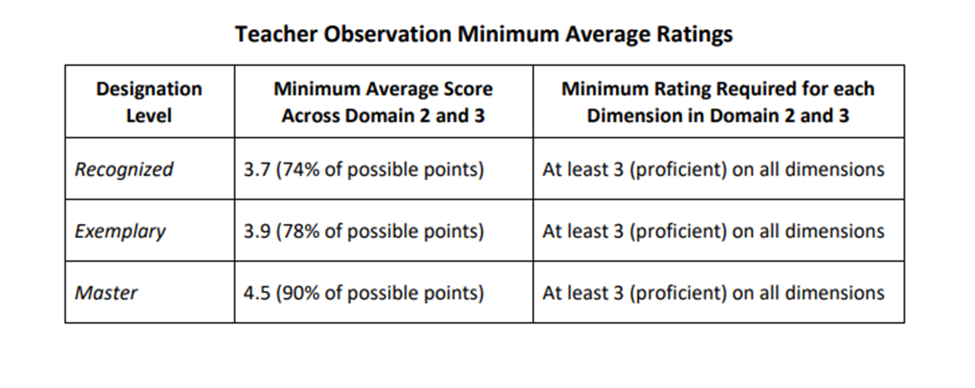
Galena Park’s – State Minimum

Slide 10
Weighting of T-TESS vs Student Growth Measure
Components for teacher’s eligibility: (GPISD - ESL Certification)
  30% of score = Teacher performance (T-TESS Domains 2 & 3)
  70% of score = Student growth measures
Final Designation Calculation
  Final T-TESS Domains 2 & 3 ____ x .30 = Final T-TESS Summative Weighted Score
  Final Student Growth Score ____ x .70 = Final Student Growth Weighted Score
Final T-TESS + Final Student Growth = Final Designation Score

Slide 11
SPENDING PLAN
~ 90% to the designated teacher
~ 10% to the district to support
rollout and implementation

Slide 12
Questions?

